Slide 1

Introduction to Image Analysis
David Herman, 11/10/2014

Slide 2
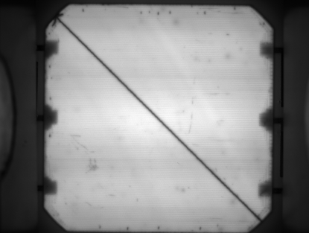
Why is Image Analysis important at SunPower
SunPower invests significant time and capital into image capture
Pre-lam/Post-lam EL images, IR inspection, Bend Tool EL, optical inspection, aesthetic quality, etc.
Typically pass fail criteria, good or bad. Better characterization or quantitative analysis is time consuming.
Can be automated by Python + OpenCV
Image Analysis can be automated to generate quantitative data on tens of thousands of images easily

Slide 3
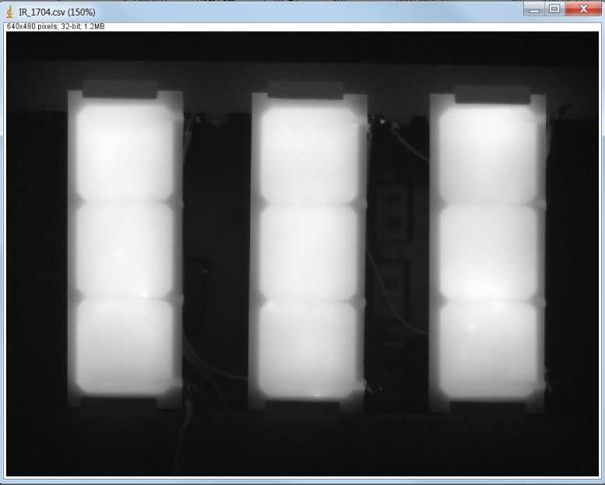
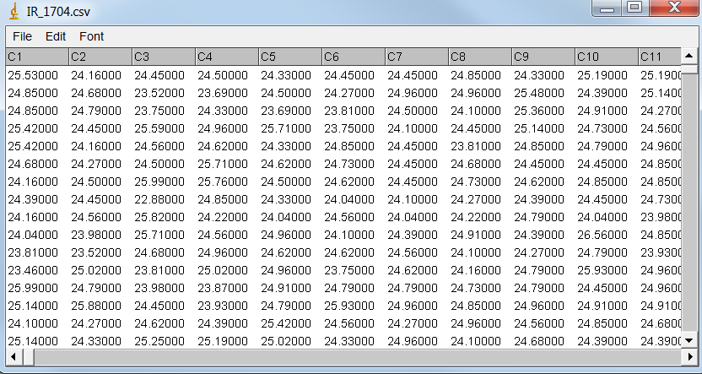
What is an Image?
Images can be represented as matrices,
Image size corresponds to the size of the image, IE 1024 X 768 pixels
Grayscale corresponds to 1 channel, color 3 channels (3 Matrices)
Bit Depth corresponds to bits in memory used to store individual pixel information
8-bit ( 0 to 255), 16-bit ( 0 to 65535) per channel
32-bit floating point csv corresponds to FLIR temperature reading

Slide 4

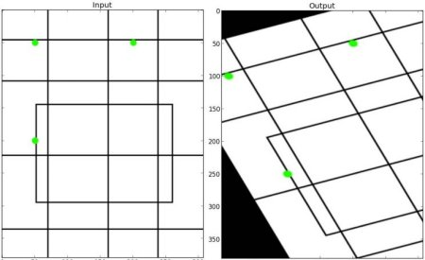
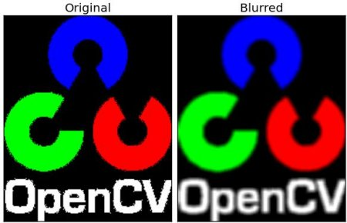
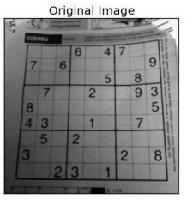
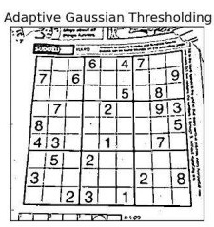
Basic Image Tools Available with OpenCV
http://docs.opencv.org/trunk/doc/py_tutorials/py_tutorials.html
http://docs.opencv.org/

Slide 5
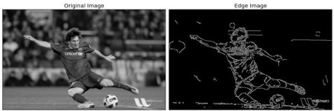
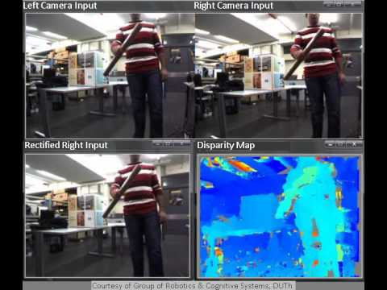
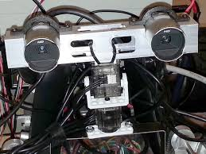
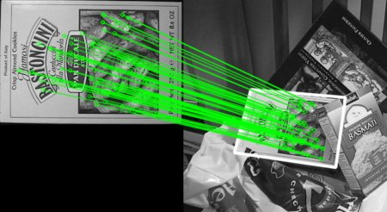
OpenCV offers many advanced image analysis features
http://docs.opencv.org/trunk/doc/py_tutorials/py_tutorials.html
http://docs.opencv.org/

Slide 6
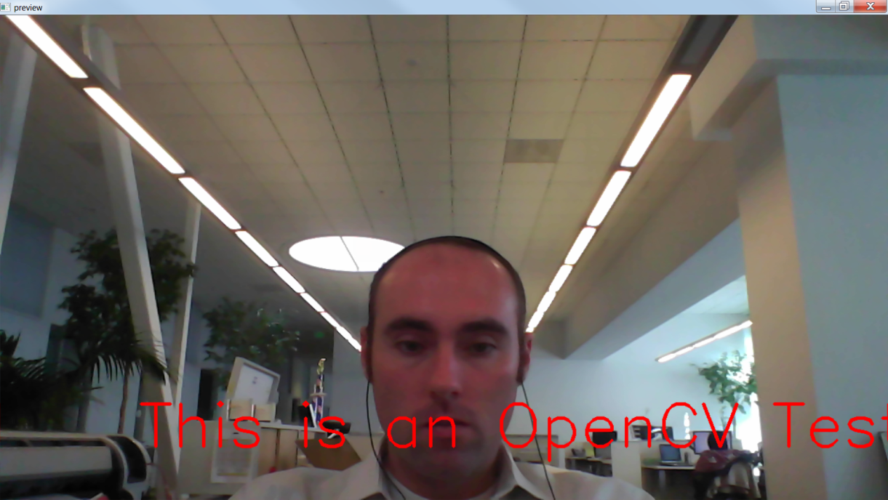
Let’s Get Started with an in Class Example
Let’s run the provided example file

Slide 7
HW assignment
Change provided example
Alter inputs, add additional parameters, perform calculations, etc
Modify or Create your own image analysis program and share with the class next week
Can be just for fun or for work
Python file and XML file provided over email

